Slide 1
Reading the World in an American Literature Class:
Postcolonial YA Novels and Cosmopolitan Youth
Kristina ByBee
English teacher / PhD student, ASU
YA Summit
June 14, 2018

Slide 2
Who, What, and why
Secondary students
Juniors
AP Language & Composition
Independent Reading Unit
AP Lang does not require literature study, but can be included
Junior year is American Literature
Research shows reading independently positively impacts literacy

Slide 3
My research interest...
The intersection between student identity and literacy (ie, what funds of knowledge do students bring to school)
Valuing students for their critical literary knowledge & skills

Slide 4
Independent Book unit Research question:
How do students perceive their experience of using Social Identity Development Theory as a lens to analyze postcolonial Young Adult novels written by American writers?

Slide 5
The books…
Written by American authors
Young Adult genre
Written by and about people of color
Protagonist experiences a challenge or change in identity
Social issues may be highlighted in plot

Slide 6
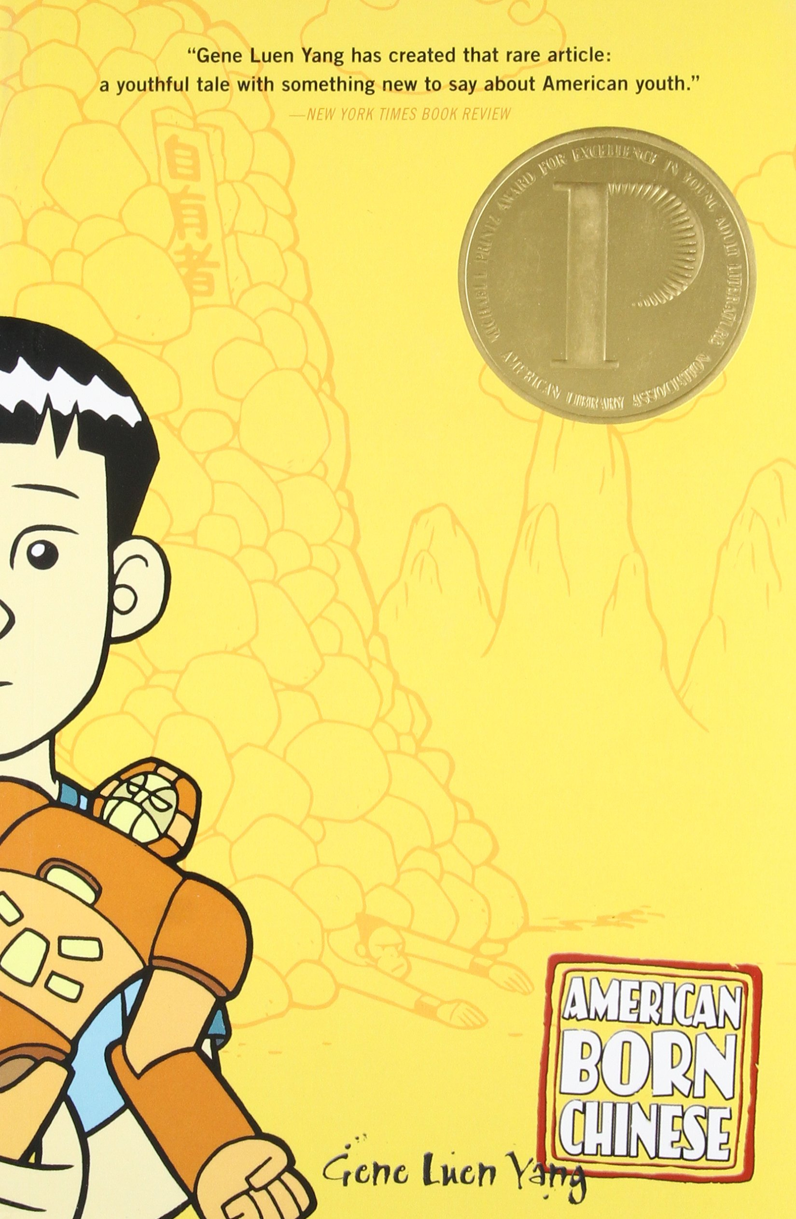
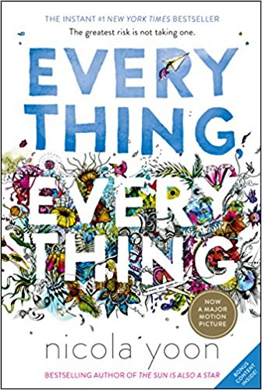
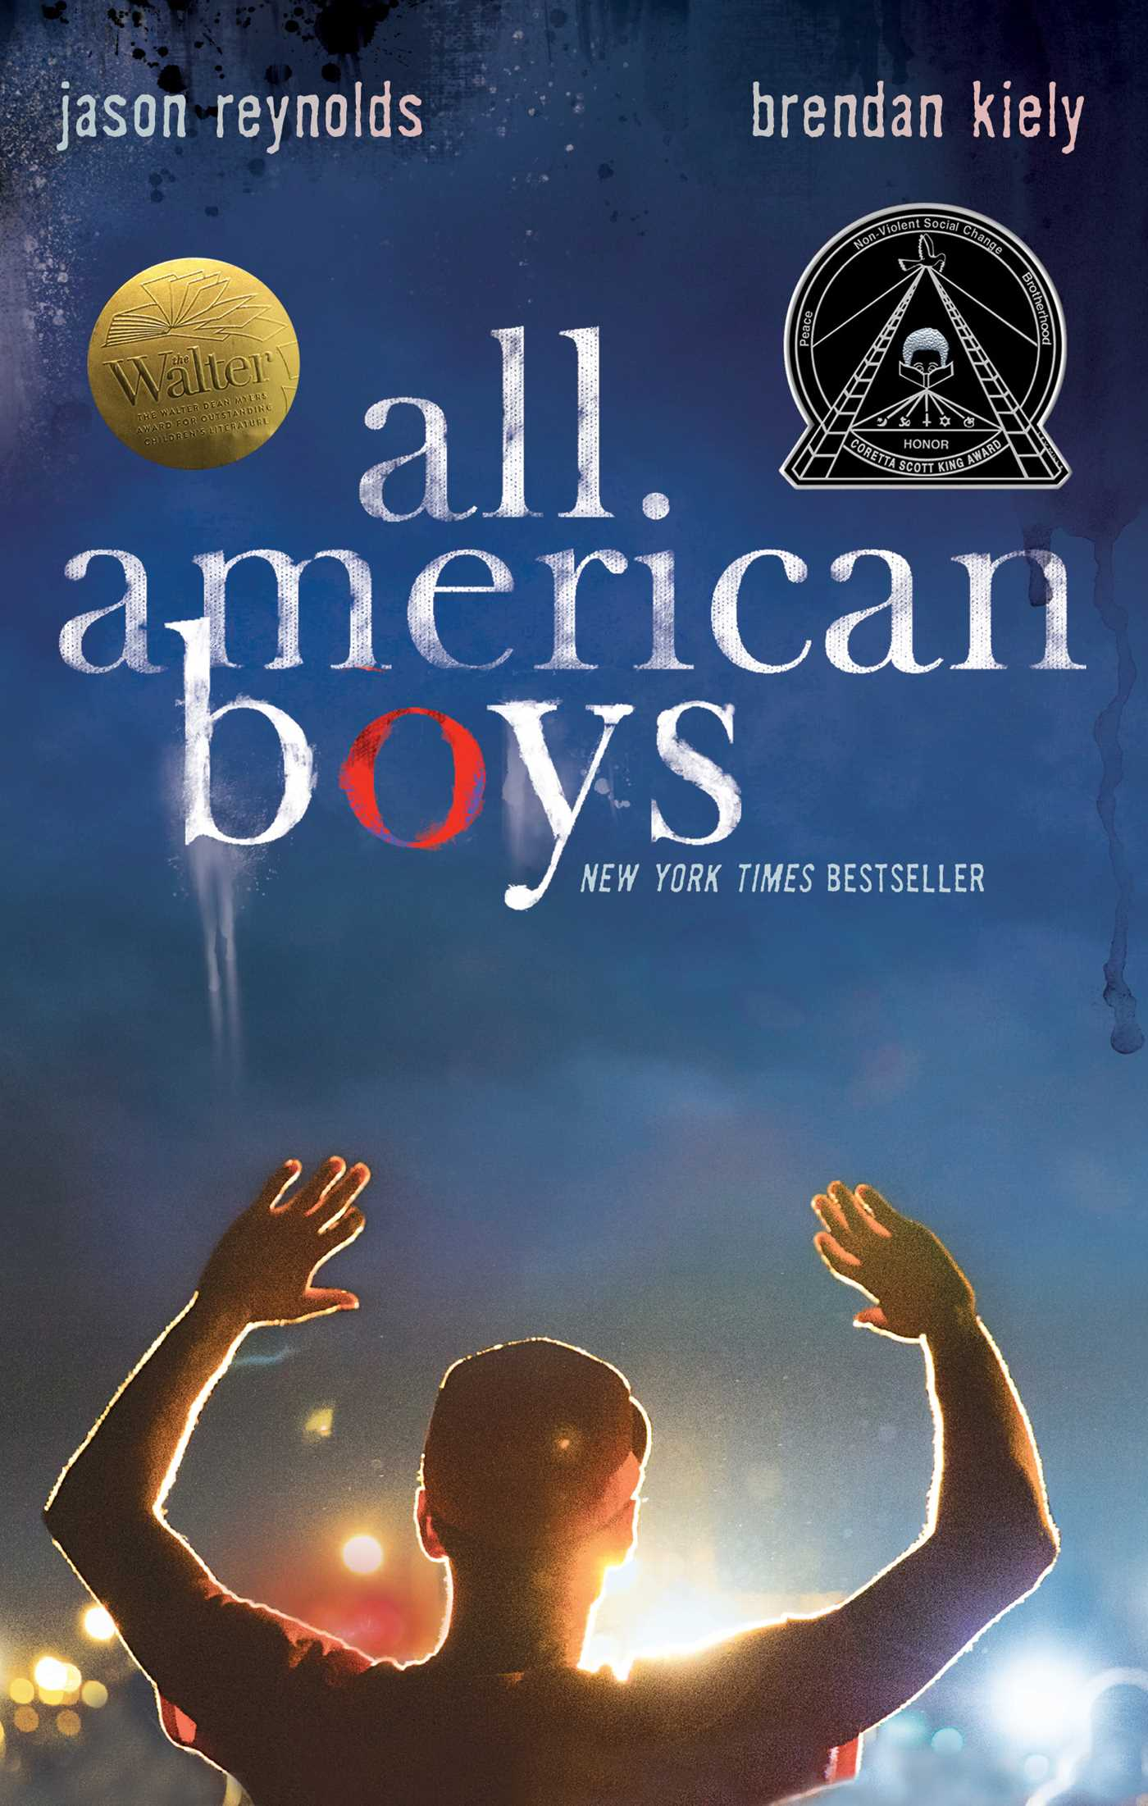

Slide 7
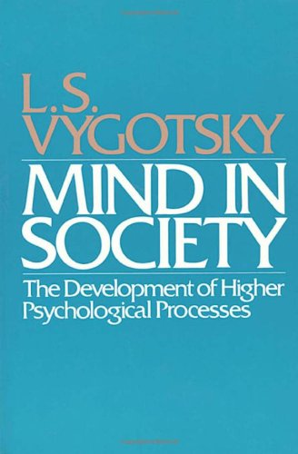
Theoretical framework
Learning is a social process
Learning is situated (all students & classrooms are different)
SocioCultural Framework (Vygotsky, 1978)

Slide 8
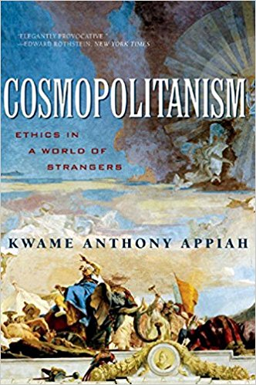
Theoretical Framework
Cosmopolitanism & Cosmopolitan Youth: “all youth are already cosmopolitan intellectuals engaged in contemporary cultural and political debates and realities with their family and friends” (DeJaynes & Curmi, 2015).
“Citizens of the world”
“Critical youth lens”
Contrary to view that youth are “becoming” or “innocent”

Slide 9
Part 1:Planning phase
Determined purpose of unit and what data I wanted to gather.
Considered students (my students are AP Language & Composition juniors) and reading selections (novel choice list).

Slide 10
Part 2: implementation phase:
Pre-reading Activities
Reading Activities
Post-reading Activities

Slide 11
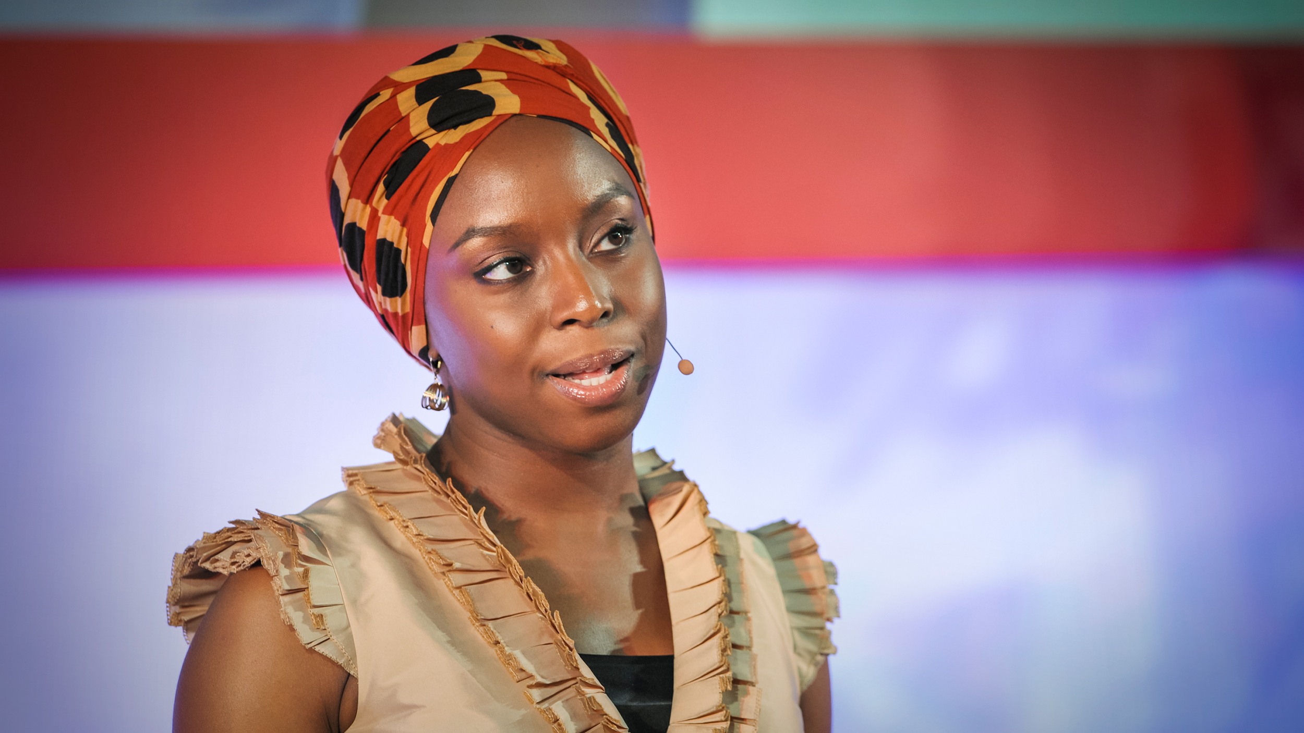
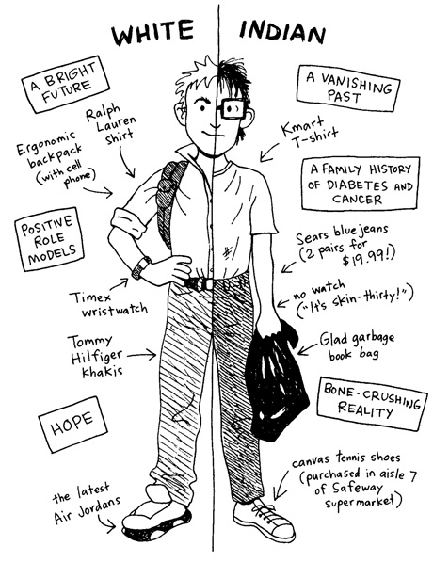
Pre-reading activities
“The Danger of a Single Story” TED Talk by Chimamanda Ngozi Adichie
Tajfel & Turner’s Social Identity Development Theory
Student version of Identity wheel
Read the short story, “Indian Education” by Sherman Alexie and practiced applying Social Identity Development Theory to main character, Junior.

Slide 12
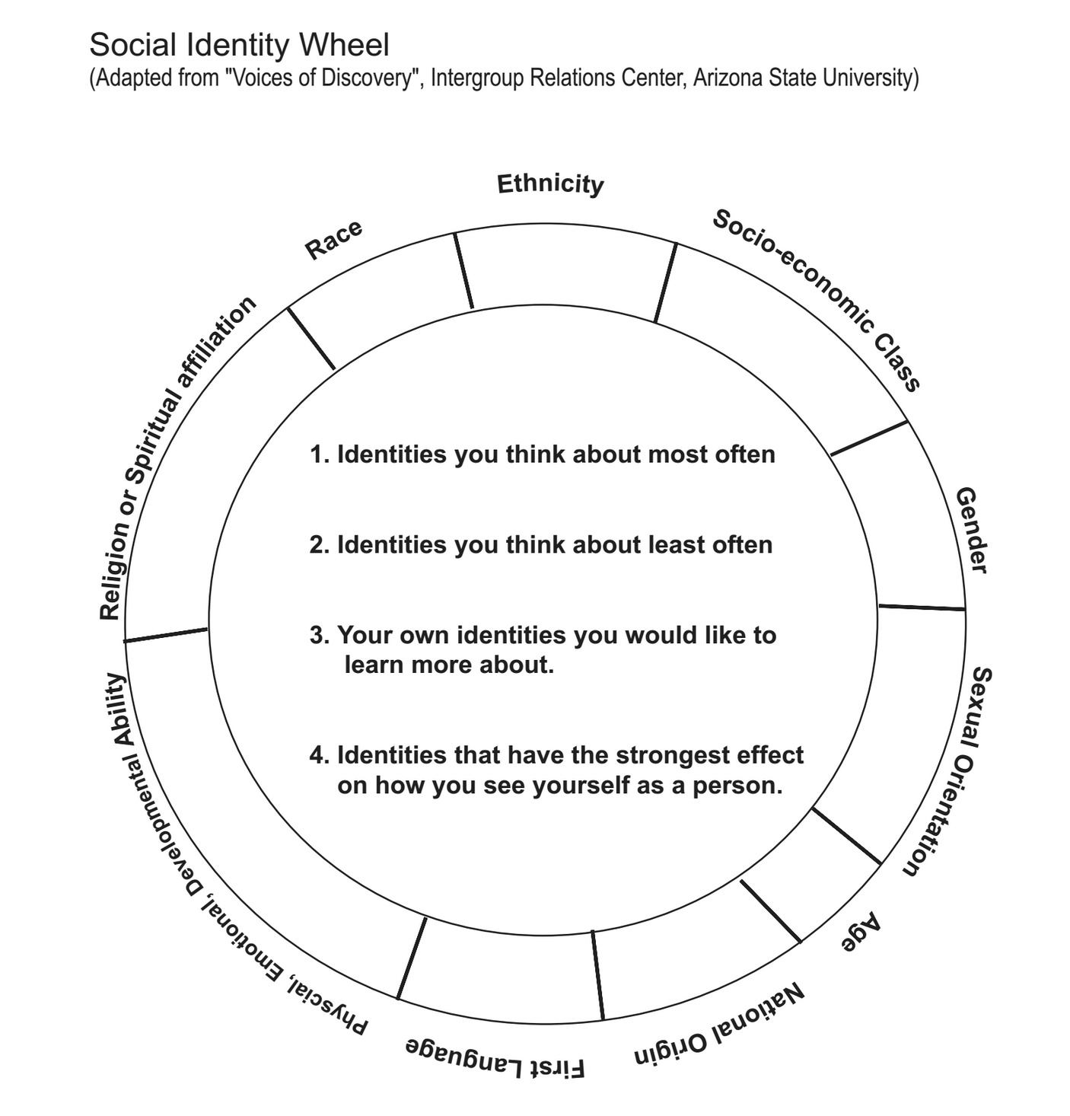
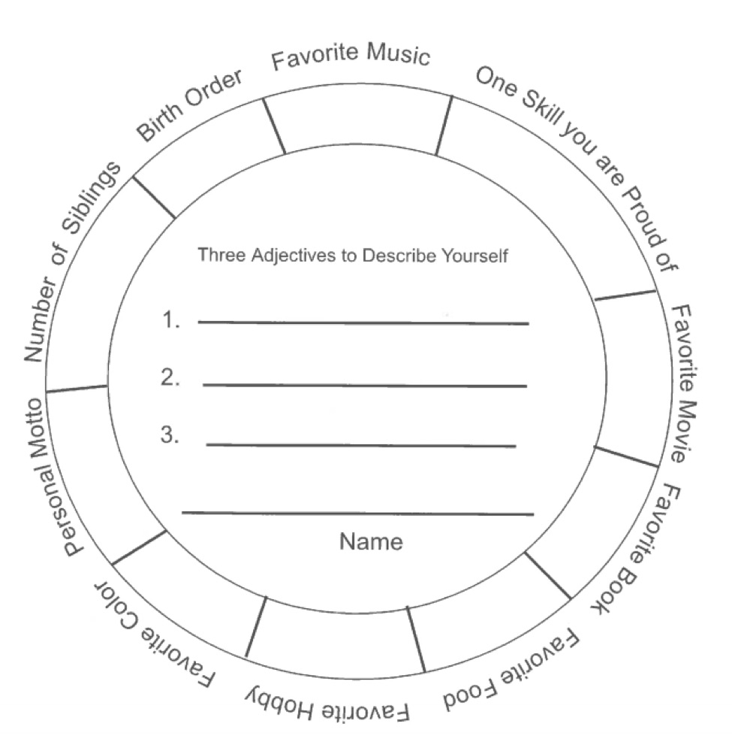

Slide 13
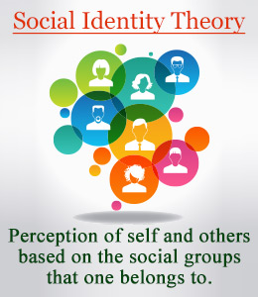
Social Identity Development theory
Tajfel & Turner, 1979

Slide 14
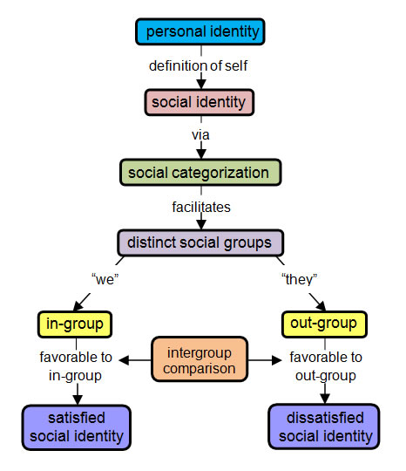

Slide 15
Reading activities
Students choose their book from the provided list; reading begins (allow reading in class when possible)
Periodic check-in activities (journaling, discussion boards, etc)
Research reviews on Amazon & Goodreads
Introduce Postcolonial terms

Slide 16
Postcolonial terms for students:
Postcolonialism
Decolonized
Race
Ethnicity
Diaspora
Native

Slide 17
Post-reading activities
Analysis essay
Apply Social Identity Development Theory as a lens for analysis
Choose 3 rhetorical devices from list; analyze author’s use in novel
Peer feedback
Revisions & Conferencing
Final draft
Book talks in small groups (required) & whole class (voluntary). Model this for students.
Reflection survey & journaling
Option to post review of novel to classroom page

Slide 18
Methods/Data collection
Student analysis essays
Pre-reading surveys (Google Forms)
Post-reading surveys (Google Forms)
Interviews with students (group and/or individual)

Slide 19
Student voices
“...I think both main characters are easy to find common ground with or make those simple connections that really make a book much better. I also think that in the end people will realize from the events that’ve happened so far that it is so easy to stereotype people and to have just one opinion of a race or ethnicity, but that’s never the way it’s supposed to be with anything.”
(All-American Boys)

Slide 20
Student voices
“I enjoy the writer’s inclusion of Spanish phrases within the story, as well as the diction and imagery she uses. Piedad is very much relatable to teens, since she exemplifies the struggle of identity most teens face. Medina depicts Piedad making decisions that impact her life in both positive and negative ways. The author presents Piedad as neither perfect nor broken, but as human.”
(Yaqui Delgado Wants to Kick Your Ass)

Slide 21
Student voices: THe hate u give
“I chose The Hate You Give. It is a wonderful book on how to use your voice even in the worst situations possible….The entire book was an eye opener to the injustices in the world. It also helped me to get rid of my single story and gain a new perspective on situations and living conditions that I would never have learned about otherwise.”
“The novel that I chose to read was The Hate You Give, and it just may be the best book I’ve ever had to read for an English class.”

Slide 22
Results
Students appreciate choice in their independent reading
Some students purposely chose a book different from their own ethnicity or culture
Students wrote about increased empathy for people & situations that they were previously unaware of
Most students made sense of the Social Identity Development theory lens
Made personal connections to the experiences of the main characters

Slide 23
Suggestions
Project can be adapted for various secondary ELA grade and ability levels to meet the needs of individual learners
Project can be adapted to focus on a particular genre (contemporary Young Adult, Science Fiction, Fantasy, Historical, nonfiction, etc.) or assigned more than once in a school year
Use alternate assignments such as creating Google sites

Slide 24
references
Appiah, A. (2006). Cosmopolitanism : Ethics in a world of strangers (1st ed.. ed.). New York: New York : W.W. Norton.
Brooks, W., & Cueto, D. (2018). Contemplating and extending the scholarship on Children’s and young adult literature. Journal of Literacy Research, 50(1), 9-30.
Durand, E. S. (2015). Understanding diversity in a global context: Preservice teachers' encounters with postcolonial young adult literature. The ALAN Review,
(Winter), 80-90.
Durand, E. S. (2016). At the intersections of identity. In D. Linville, & D. L. Carlson (Eds.), Beyond borders: Queer eros and ethos (ethics) in LGBTQ young adult
literature (). New York, Frankfurt , Berlin: Peter Lang Publishing, Inc.
Christensen, L. (2000). In Rethinking Schools L. M.,WI (Ed.), Reading, writing, and rising up teaching about social justice and the power of the written
word. S.l.]: S.l. : Distributed by ERIC Clearinghouse.
Glasgow, J. N. (2001). Teaching social justice through young adult literature. The English Journal, 90(6), 54-61.
Hinchman, K. A., & Appleman, D. (2017). Adolescent literacies : A handbook of practice-based research New York : Guilford Press.
Malo-Juvera, V. (2017). A postcolonial primer with multicultural YA literature. English Journal, 107(1), 41-47.
Seymour, M. (2004). Educating for humanity : Rethinking the purposes of education. Boulder, CO : Clinton, Wash.: Boulder, CO : Paradigm Publishers ; Clinton, Wash. : Heritage Institute.
Vygotskiĭ, L. S. (Lev Semenovich). (1978). In Cole M. (Ed.), Mind in society : The development of higher psychological processes. Cambridge: Cambridge : Harvard University Press.

