Slide 5
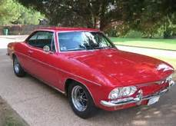

Slide 7
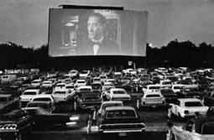
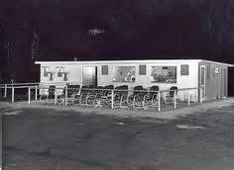

Slide 11
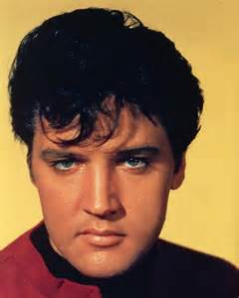

Slide 12
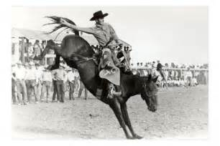

Slide 16
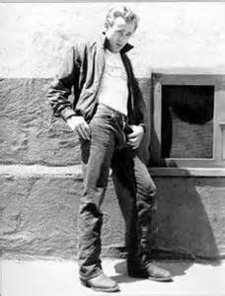

Slide 23
Related Authors
Cynthia Voight
M. E. Kerr
Paul Zindel
Robert Lipsyte
Robert Cormier
Chaim Potok
Bette Greene
Virginia Hamilton
Robert Newton Peck
Judy Blume
Lois Duncan

